Slide 1
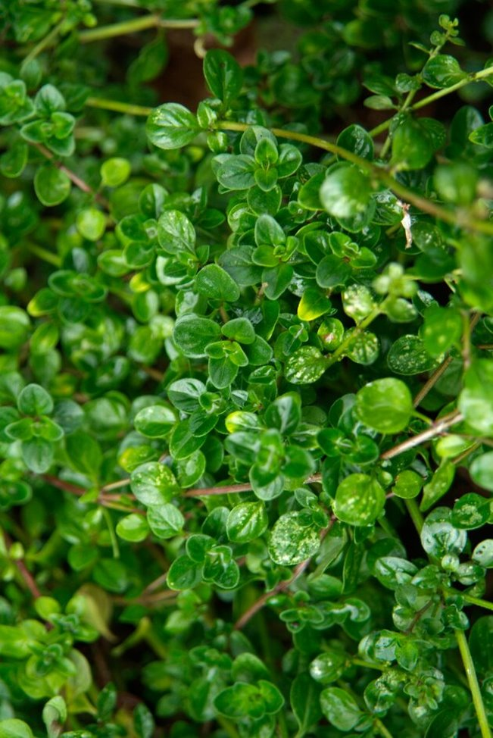
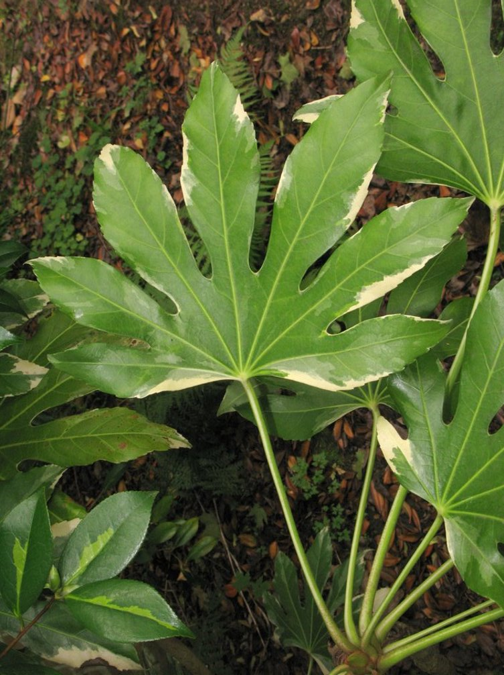
BIG leaves...or small leaves?
Lots of leaves or big leaves can have a cooling effect on an area (like Japanese Aralia)
Lots of small leaves e.g. a hedge, can help with capturing air pollution, flood risk, noise reduction, and supporting wildlife!
Plants such as thyme can manage flow of water, and can manage in extreme weather like hot and dry periods
Thyme
Japanese Aralia
Images © RHS
Notes:
https://www.rhs.org.uk/plants/types/hedges/with-environmental-benefits
https://www.rhs.org.uk/science/pdf/climate-and-sustainability/hedges-for-environmental-benefits.pdf

Slide 2
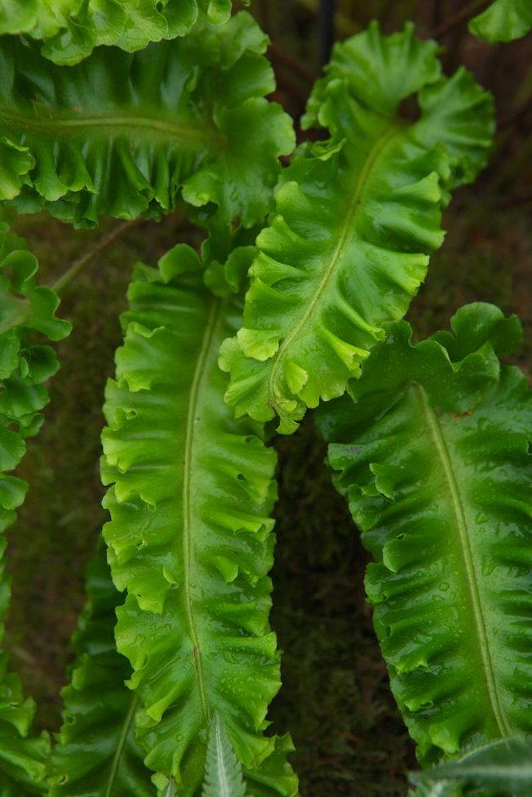
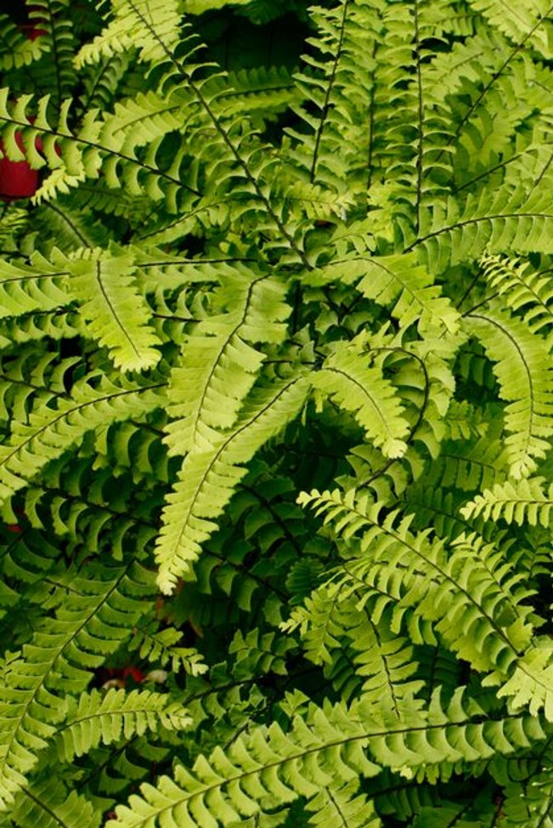
Ferns and repetitive patterns
Ferns like lots of water and shade, so can grow in places prone to flooding
Hart's Tongue Fern can deal with increased rainfall, as well as dealing with our increased temperatures
The repetitive patterns in ferns can also be relaxing, as looking at them can allow our brain and eyes to rest!
Hart's Tongue Fern
Maidenhair Fern
Images © RHS

Slide 3
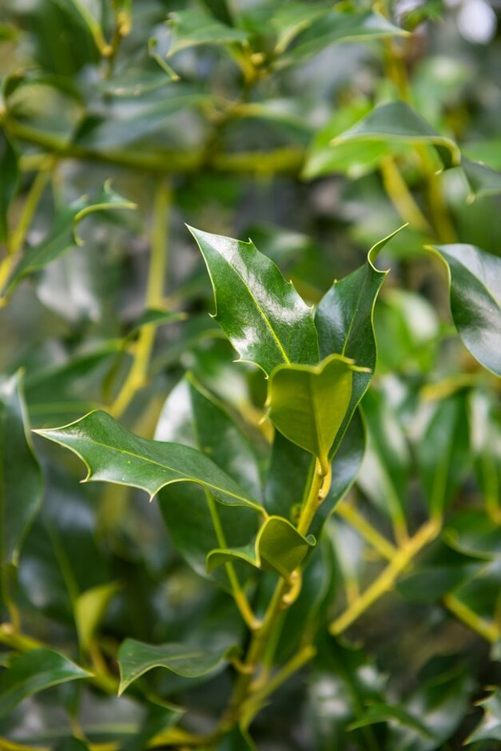
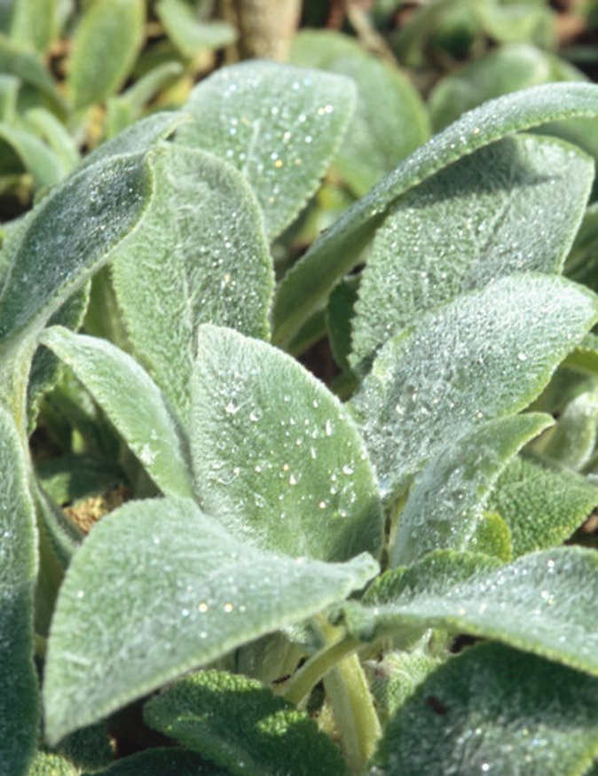
Waxy leaves...or hairy leaves?
Waxy leaves protect water inside the leaf – thicker waxy leaves can also help reflect sound
Holly is a good hedge plant with environmental benefits, like reducing noise, and supporting wildlife
Hairy leaves (such as lamb's ear) can also stop water evaporating, and the hairs can trap air pollution, cleaning the air around the plant!
Lamb's ear is also a good plant for extreme weather, and can cope with hot and dry periods mixed with intense bouts of rain
Holly
Lamb's ear
Images © RHS
Notes:
https://www.rhs.org.uk/plants/types/hedges/with-environmental-benefits
https://www.rhs.org.uk/science/pdf/climate-and-sustainability/hedges-for-environmental-benefits.pdf

Slide 4
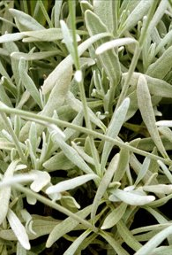
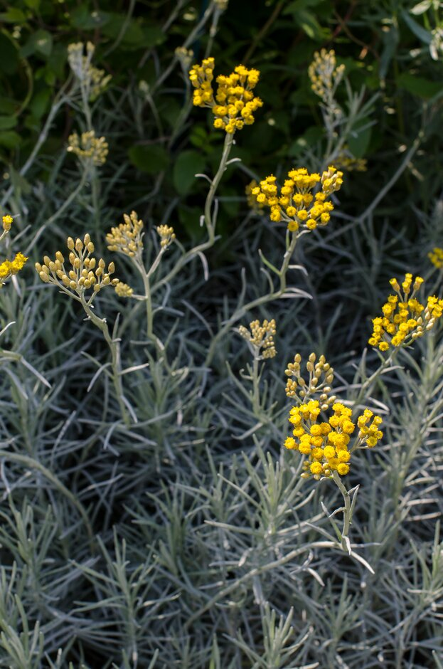
What about silver leaves?
Silver leaves, like those on lavender, are good at reflecting light, so can grow in very sunny spots and warm weather
Curry plant is also a good plant for extreme weather (hot and dry periods, as well as intense rain)
Lavender
Curry plant
Images © RHS
Notes:
Lighter coloured leaf = cooling effect https://www.rhs.org.uk/science/pdf/climate-and-sustainability/hedges-for-environmental-benefits.pdf

Slide 5
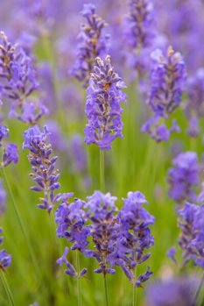
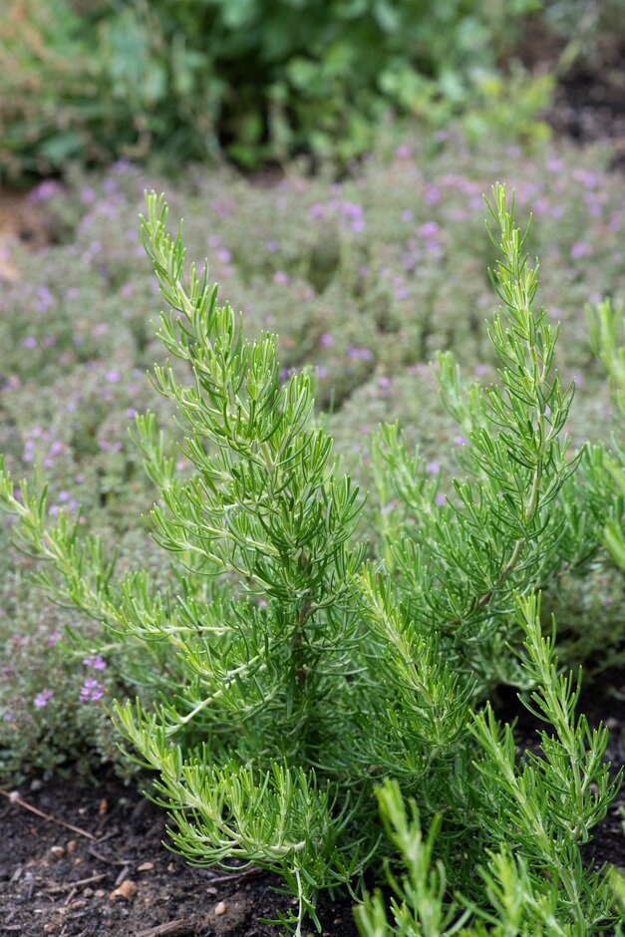
Scent
Plant scents can attract pollinators to their flowers, or deter pests from eating them - but can also be enjoyed by people too
Lavender's scent can be relaxing for some people
The scent of rosemary can also be uplifting for some people!
Lavender
Rosemary
Images © RHS
Notes:
https://schoolgardening.rhs.org.uk/resources/info-sheet/plants-for-a-sensory-garden
https://www.rhs.org.uk/science/articles/scent-and-emotion

Slide 6
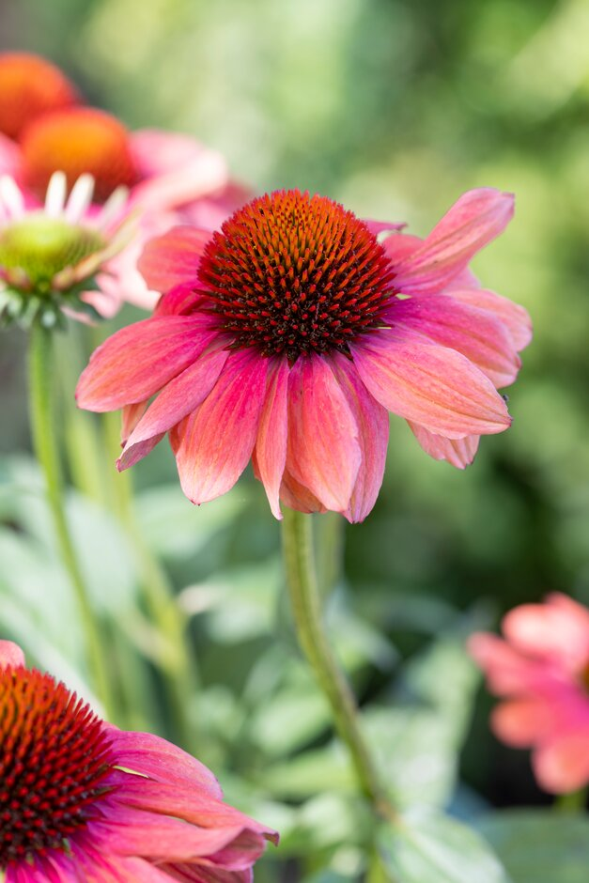
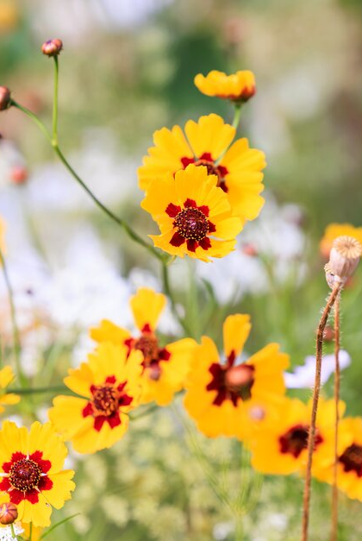
Colour and flowers
Plants with colourful flowers, that you like the colour of, can promote positive emotions
Flower shapes such as daisy, give a high reward for pollinators as there are lots of flowers in one location
Plants like coneflower guide pollinators to the centre of the flower to find nectar
A wide range of flower types and heights will attract a range of pollinators – bees aren't the only pollinators! Butterflies, flies, wasps, beetles, moths and birds are also pollinators
Coneflower
Coreopsis (daisy-like flowers)
Images © RHS
Notes:
https://www.rhs.org.uk/science/pdf/conservation-and-biodiversity/wildlife/plants-for-pollinators-garden-plants.pdf
https://www.rhs.org.uk/science/pdf/conservation-and-biodiversity/wildlife/plants-for-pollinators-wildflowers.pdf

